Slide 1
COSC 214 GROUP PROJECT
Evaluating Data Structures
COSC 214 Professor Sarker
By Robert Lawrence, Abimbola Adedeji, Robert Johnson

Slide 2
THE VISION
We are evaluating how different data structures perform when managing patient records.
Compare how different data structures store and manage patient records
Measure performance for insert, search, delete, and traversal
Relate observed performance to algorithm efficiency

Slide 3
THE VISION
Healthcare Dataset Fields
‘Patient Record’ Model
ID
Age
Medical Condition
Hospital
Admission Type
Billing Amount
Each dataset row is converted into one ‘Patient Record’
We use a simplified set of fields instead of every dataset column
Patient ID is used as the main key for searching and deleting

Slide 4
Operations Implemented
v
01
Adds a new patient record to the structure
Time Complexity: O(1) on average
Simulates adding new data into the system
insertRecord()
02
searchRecord()
Finds a patient record using a unique ID
Time Complexity: O(1) average (hash), O(n) for arrays and linked lists
Used to locate specific records quickly
03
deleteRecord()
Removes a record based on ID
Time Complexity: O(1) to O(n) depending on structure
May require shifting (array) or relinking (linked list)
04
traverseRecords()
Iterates through all records in the structure
Time Complexity: O(n)** (must check every element)**
Used for displaying or processing all data

Slide 5
Data Structures Used
Dynamic Array
Hash Structure
Fast access by index → O(1) access time
Insertion at end is efficient → O(1) amortized
Deletion/search can be slower → O(n) due to shifting elements
Linked List
Very fast search, insert, delete → O(1) average
Uses key (ID) for direct access
Performance can degrade → O(n) in worst case (collisions)
Queue / Priority Queue
Efficient insertions/deletions → O(1) (if position is known)
No shifting required (unlike arrays)
Searching is slower → O(n) (must traverse nodes)
Processes data in order (FIFO or priority-based)
Insertion/removal efficient → O(1) (queue) or O(log n) (priority queue)
Not efficient for searching → O(n)

Slide 6
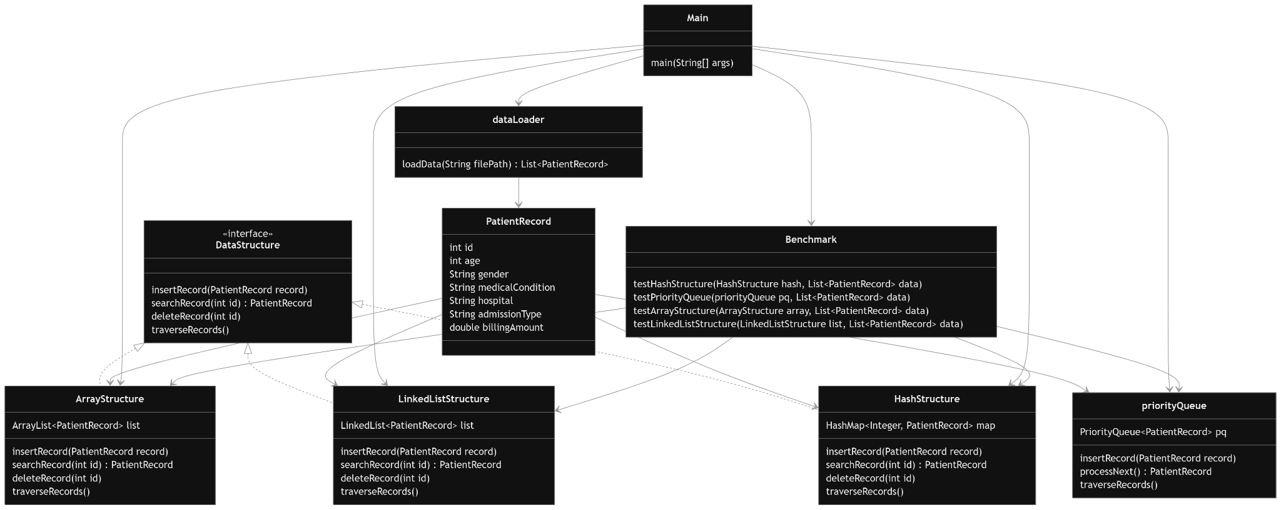
UML Diagram

Slide 7
THE VISION
Test insert, search, and delete operations
Use dataset sizes such as 100, 1000, 5000, and 10000 records
Run each test multiple times and average the runtime
Measure runtime using System.nanoTime()
Benchmark Plan

Slide 8
ArrayList performed well for insertion because new records can be added to the end efficiently. However, search and delete become slower as the dataset grows because the structure must scan through records one by one. Deletion is also costly because elements may need to shift after a record is removed.
Fast insertion at the end
Search requires scanning → O(n)
Delete is slow due to shifting elements
Performance decreases as dataset grows
ARRAYLIST ANALYSIS

Slide 9
LinkedList is useful when records are frequently added or removed because it does not require shifting like an ArrayList. However, searching is still slow because each node must be checked one at a time. In the benchmark, LinkedList had reasonable delete performance but search time increased as the dataset size grew.
Efficient insert and delete (no shifting)
Search requires traversal → O(n)
Performs better than ArrayList for delete
LINKEDLIST ANALYSIS

Slide 10
PriorityQueue is best for priority-based processing, not general searching. It works well when the system needs to process the highest-priority patient first, such as emergency admissions. However, search and delete are slower because the program must scan through the heap to find a specific patient ID. Its main strength is ordering records by priority.
Orders records by priority (billingAmount)
Efficient insertion → O(log n)
Search and delete are slow → O(n)
PRIORITYQUEUE ANALYSIS

Slide 11
HashMap was the strongest structure for search and delete operations. Since each patient record is stored using the patient ID as the key, the program can access records directly instead of scanning through the whole dataset. This explains why HashMap search and delete times were much lower than the other structures.
Uses key-value storage (ID → record)
Extremely fast search → O(1) average
Fast delete and insert
HASHMAP ANALYSIS

Slide 12
BENCHMARK ANALYSIS LINK

Slide 13
CONCLUSION
THANK YOU
Any questions?

